Slide 1
ARDUINO BASED SMART LIQUEFIED PETROLEUM GAS SYSTEM FOR DOMESTIC APPLICATION
Submitted By,
EE04
S.AGATHEESWARAN(951517105001)
A.AROCKIA EDWIN(951517105003)
A.MUTHU KUMAR(951517105017)
Department of Electrical and Electronics Engineering,
Kalasalingam Institute of Technology
Krishnankoil.
Guided by,
Ms.N.SELVA RANI , M.E.,
Assistant Professor
Department of Electrical and Electronics Engineering,
Kalasalingam Institute of Technology
Krishnankoil.

Slide 2
ABSTACT:
While LPG is used in every homes for cooking, LPG gas leakages may cause accidents. To avoid those accidents, We use the Smart LPG Security System.
The Smart LPG Security System gas detector detects the leakage and let us know with the help of a LCD Display and a buzzer. We use Arduino UNO to control the Smart LPG Security System .
It is developed to automatically cut the gas flow using a solenoid valve. That function protects our houses from the disasters.
We Used Air Exhauster that remove the leakage gases.
Thus, We build the low cost automatic LPG leakage detector and controller.

Slide 3
EXISTING SYSTEM:
1.LPG leakages are sensed by a MQ-2 sensor.
2. Arduino Mega continues sending messages as “GAS LEAKAGE” to a predefined mobile number using a GSM module after the leakage.
3. When LPG leakage is detected, The gas flow is cut by a solenoid valve Control With the Application.
4. It also indicates the leakage via a LCD module .

Slide 4
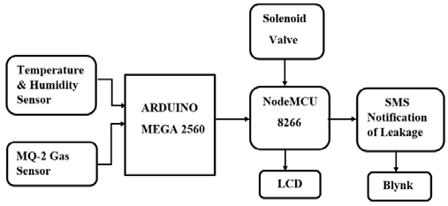
EXISTING BLOCK DIAGRAM:

Slide 5
PROPOSED SYSTEM:
The proposed System uses Arduino UNO to develop the project that is an advanced and a powerful tool to use in most of the related projects nowadays.
The operation is perfectly executable. It detects the leaked gas and indicates with the specific sound to create awareness with the help of a buzzer.
The LCD display shows whether the gas leakage happened or not.
Another important thing is that the gas leakage is detected by the sensor and the valve is closed automatically.
An exhaust air system is used to drain the air which contains LPG in it.

Slide 6
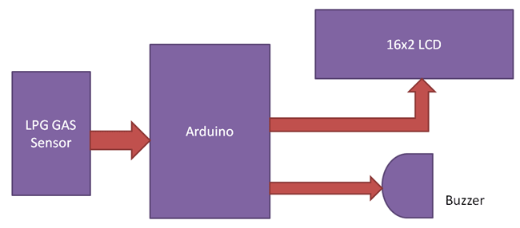
BLOCK DIAGRAM:
Solenoid
Valve
Buzzer
And
Solenoid valve, Air Exhauster

Slide 7
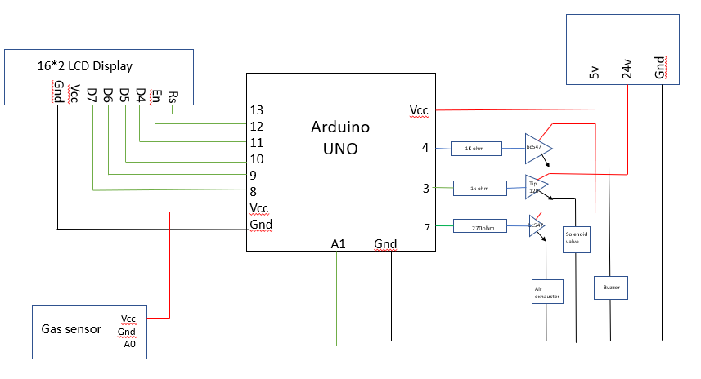
PROPOSED SYSTEM CIRCUIT DIAGRAM: DIAGRAM:

Slide 8
WORKING:
We use a MQ-2 Gas sensor to detect LPG leakages.
When Arduino UNO gets a HIGH pulse from the MQ-2 Gas sensor, It shows “LPG Gas Leakage Alert” message on the 16x2 LCD .
When the signal is received from the MQ-2 sensor, The buzzer is activated to make sound to create awareness.
And it activates the solenoid valve to close and stop the gas flow.
An exhaust air system starts to drain the air which contains LPG in it after LPG leakage occurred and got detected by the MQ-2 sensor.

Slide 9
MODEL OF PROPOSED SYSTEM :

Slide 10
ADVANDAGES:
Cost is low and the circuit is really simple.
Operating speed is high.
It is an automatic system so, Safety is high.
Performance is high and sensitivity is high.
Simple coding to change the settings of the detector.
Leaked gas gets drained to the atmosphere from the room
using an exhaust air system.

Slide 11
DISADVANDAGES :
Some coding knowledge is needed to create the project.
The Connection must be safe and secure.
Gas leakages due to the loose cylinder to valve connection cannot be controlled.
It does not send any messages to the user.

Slide 12
APPLICATIONS:
Kitchens in houses.
Cooking places in hotels and hostels.
LPG gas using areas.
Power plants .

Slide 13
REFERENCES :
[1] Ankit Sood, Babalu Sonkar, Atul Ranjan, Ameer Faisal, “Microcontroller Based LPG Gas Leakage DetectorUsinbg GSM Module, International Journal of Electrical and Electronics Research, Vol.3 , Issue.2 , pp: (264-269) ,Month: April- June 2015.
[2] Alan M John, Bhavesh Purbia, Ankit Sharma, Mrs. A.S Udapurkar, “ LPG/CNG Gas Leakage Detection System with GSM Module”, International Journal of Advanced Research in Computer and Communication Engineering, Vol.6 Issue 5, May 2017.
[3] Luay Friwan, Khaldon Lweesy , Aya Bani-Salma , Nour Mani. “A Wireless Home Safety Gas Leakage Detection System”, IEEE 2011.

Slide 14
THANK YOU!!

